Slide 1
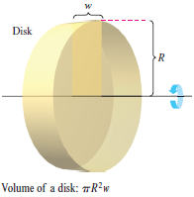
Volume : Disk Method

Slide 2
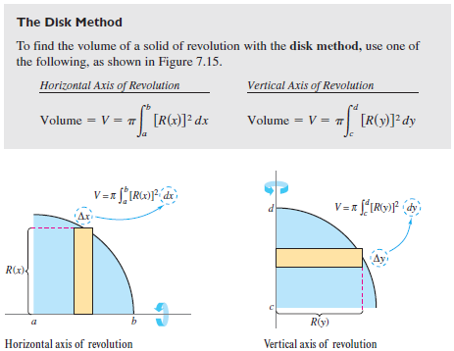
Volume : Disk Method

Slide 3
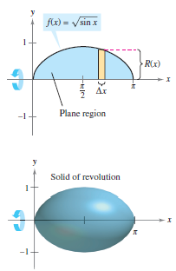
Volume : Disk Method

Slide 4
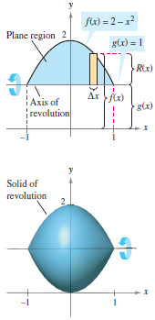
Volume : Disk Method

